Slide 1
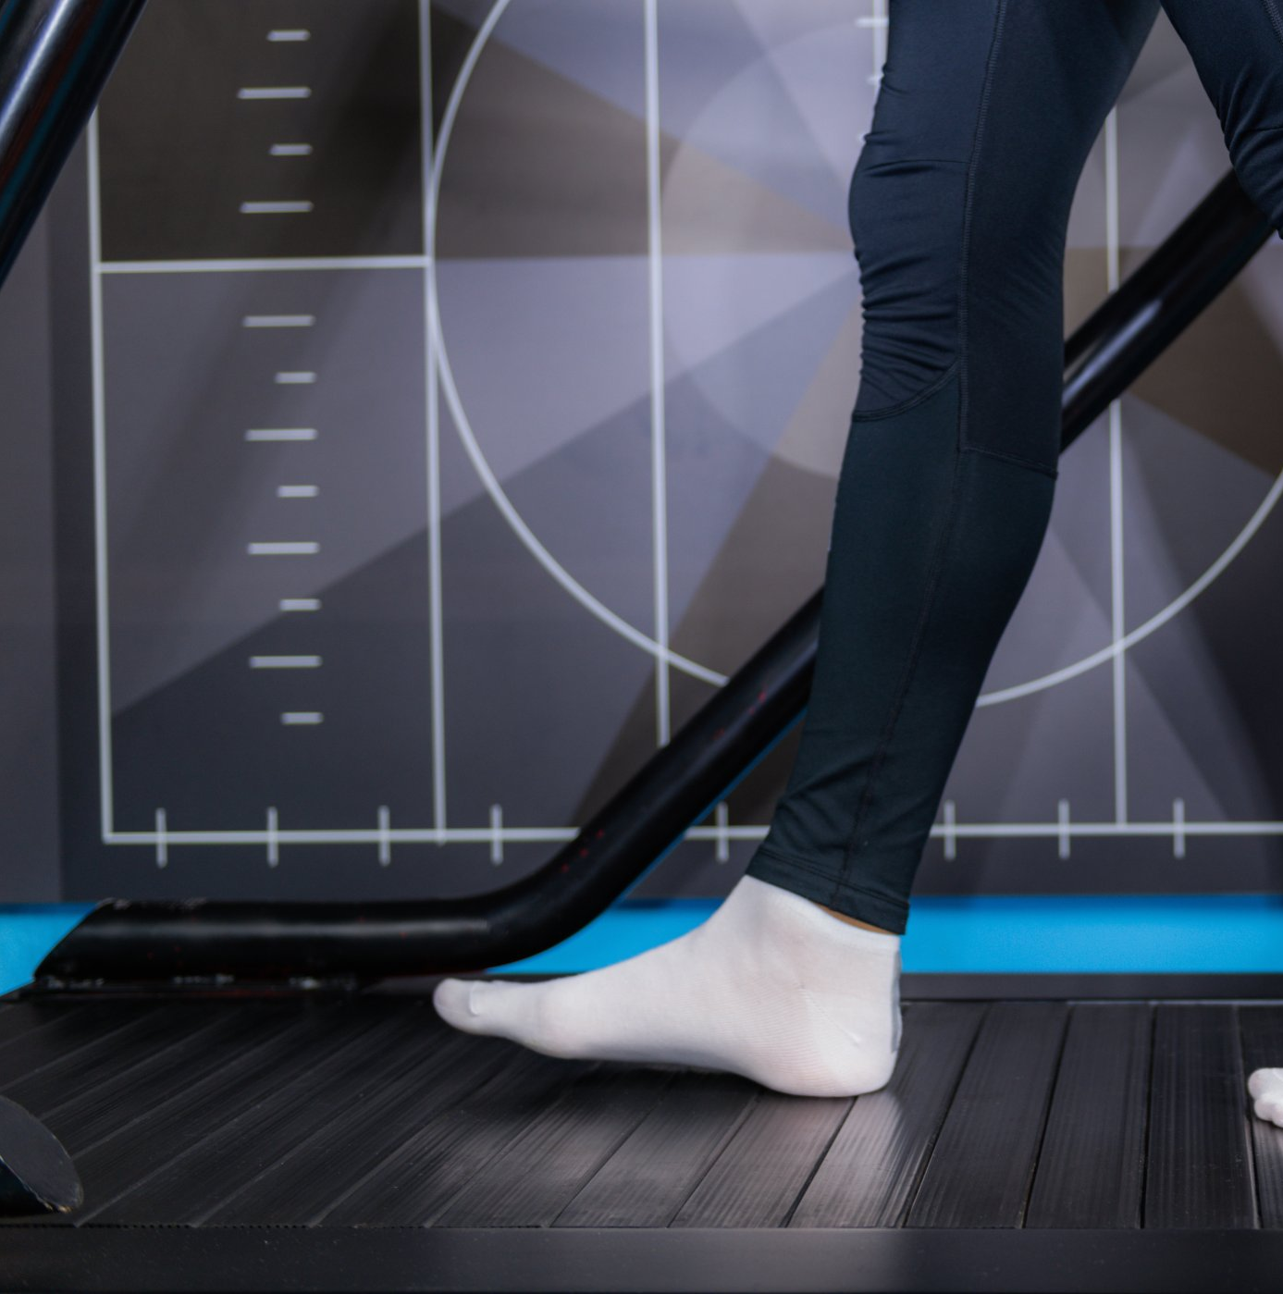
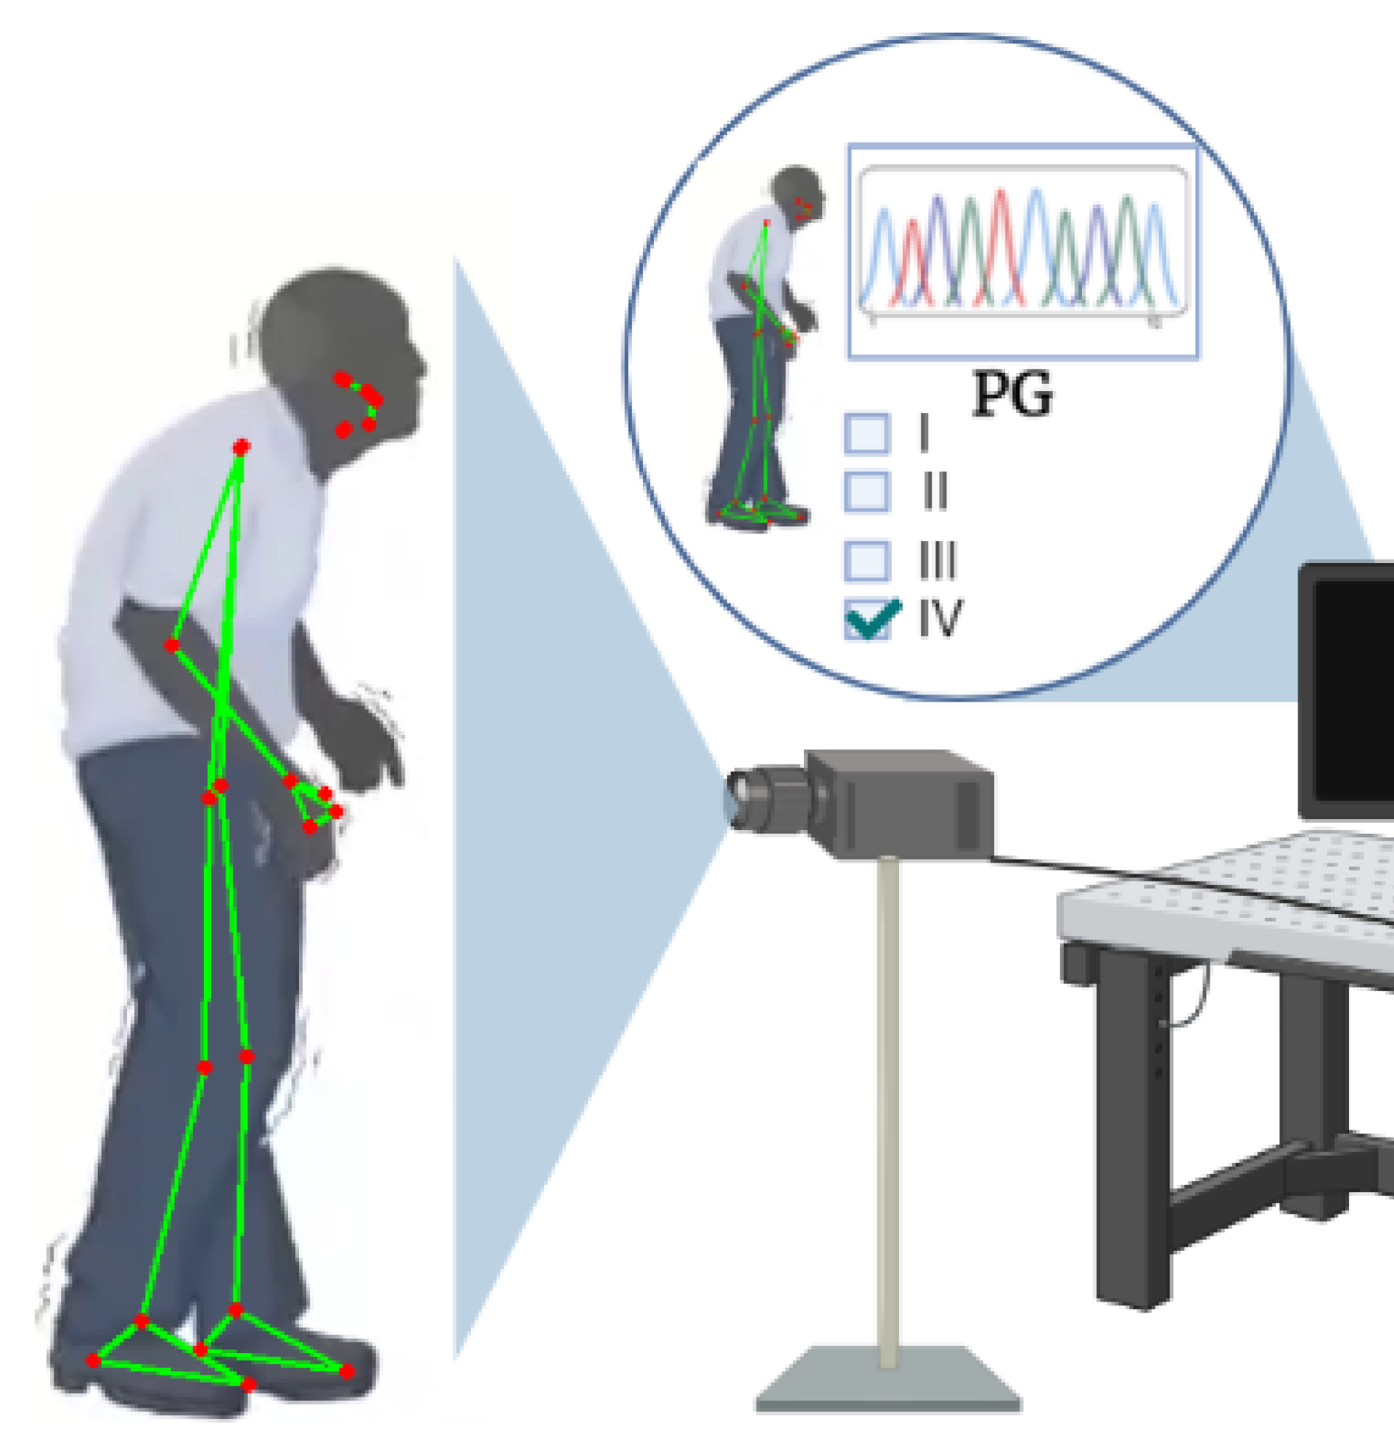
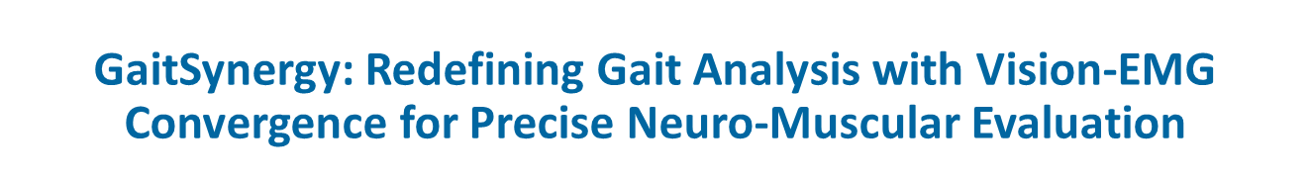
Slot no. : S1051098

Slide 2

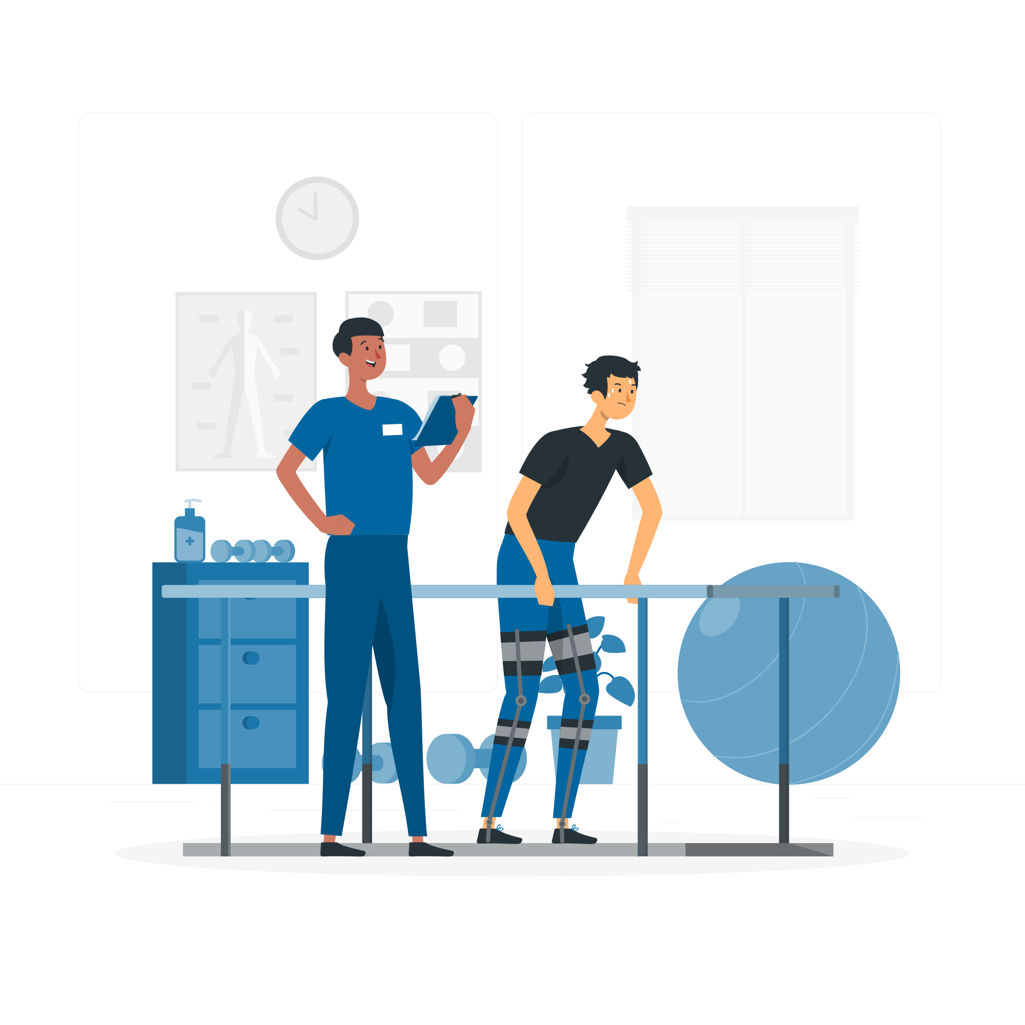
GaitSynergy: Redefining Gait Analysis with Vision-EMG Convergence for Precise Neuro-Muscular Evaluation
Introduction
Gait analysis, a fundamental component of human biomechanics, plays a pivotal role in understanding locomotion patterns and diagnosing neuromuscular disorders.
Stroke
About 1,85,000 strokes occur every year in India.
This introduces to a groundbreaking project that seamlessly integrates computer vision and electromyography (EMG) to offer a holistic and cost-effective solution for comprehensive gait analysis, surpassing the limitations of conventional techniques.
Cerebral Palsy
In India, the estimated incidence is around 3/1000 live births.
Parkinson's disease
According to a study, India has 7 million elders afflicted with Parkinson’s.

Slide 3
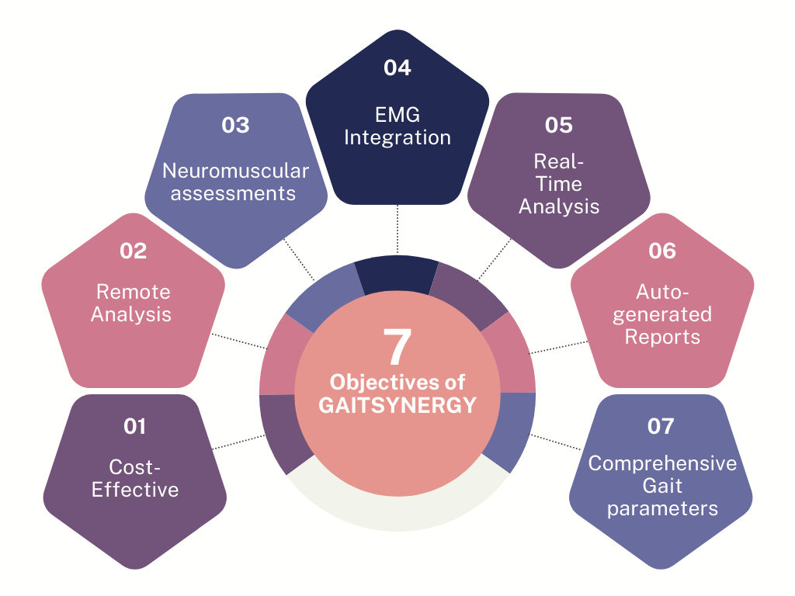
GaitSynergy: Redefining Gait Analysis with Vision-EMG Convergence for Precise Neuro-Muscular Evaluation
OBJECTIVE

Slide 4
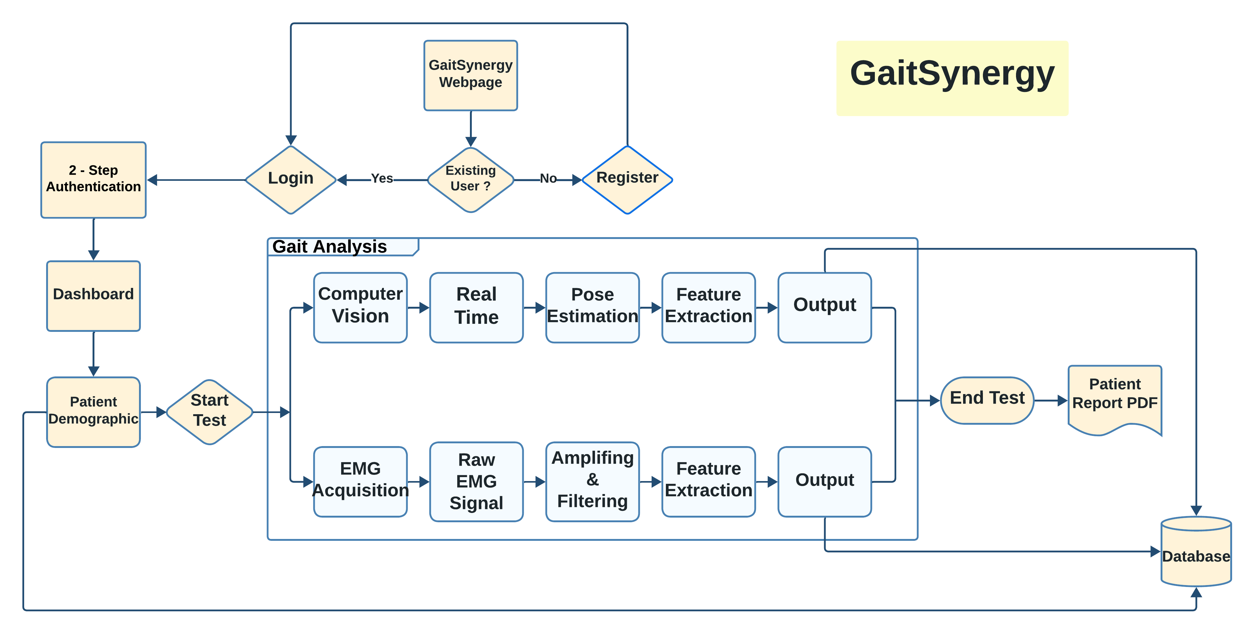
GaitSynergy: Redefining Gait Analysis with Vision-EMG Convergence for Precise Neuro-Muscular Evaluation
Proposed System & Methodology

Slide 5
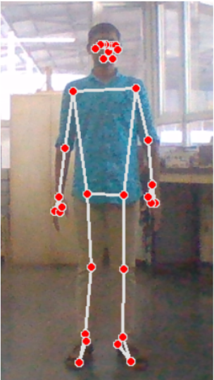
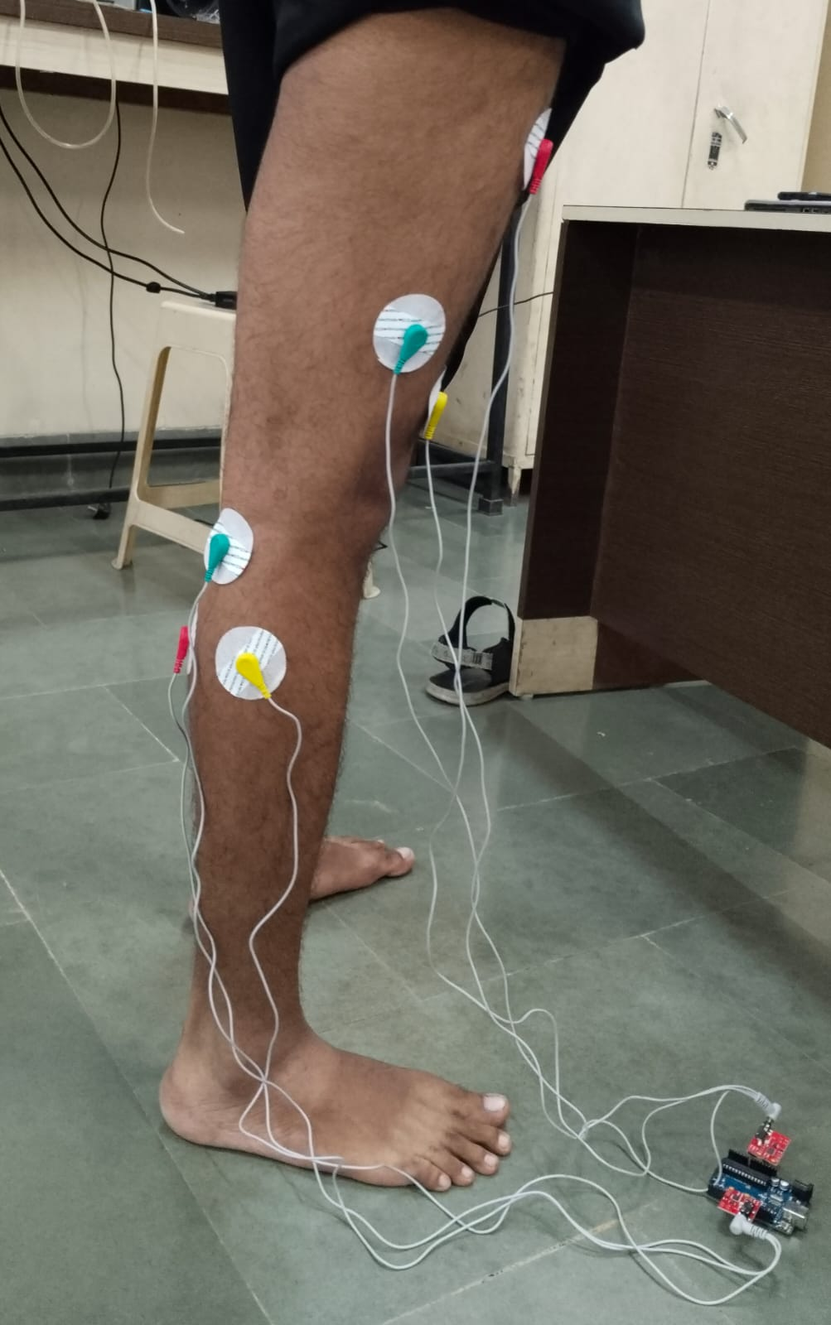
GaitSynergy: Redefining Gait Analysis with Vision-EMG Convergence for Precise Neuro-Muscular Evaluation
Proposed System & Methodology
Fig.1. The figure above shows computer vision.
Fig.2. The figure above shows EMG placement

Slide 6

GaitSynergy: Redefining Gait Analysis with Vision-EMG Convergence for Precise Neuro-Muscular Evaluation
COMPETITIVE ADVANTAGES
Our Model
Traditional Method
Integration of both computer vision and EMG for enhanced accuracy.​ ​
Provides real-time and objective gait analysis.​
​
Captures Comprehensive Gait parameters.​ ​
Offers a cost-effective setup​ and maintenance.​ ​
Eliminates need for specialized markers.​ ​
Wide range application.​ ​
Remote analysis.​ ​
​
Relies only on Computer Vision only.​ ​
Manual interpretation tends to be
time-consuming and subjective.​ ​
Limited in comprehensive capture.​
​
Can be expensive to set up and maintain.​
​
Requires specialized ​markers.​ ​
Often specialized for clinical use.​ ​
In-person analysis.​
​
​

Slide 7
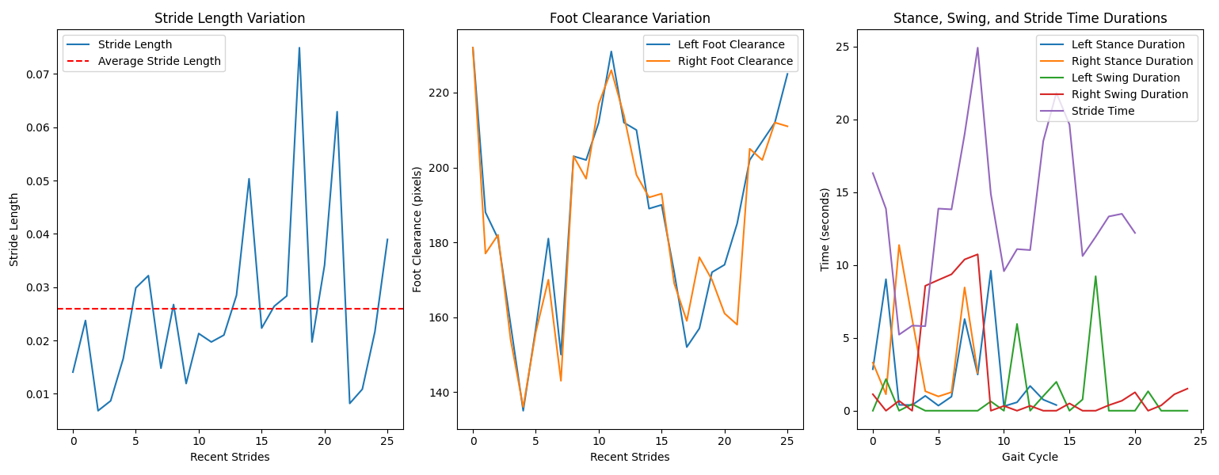
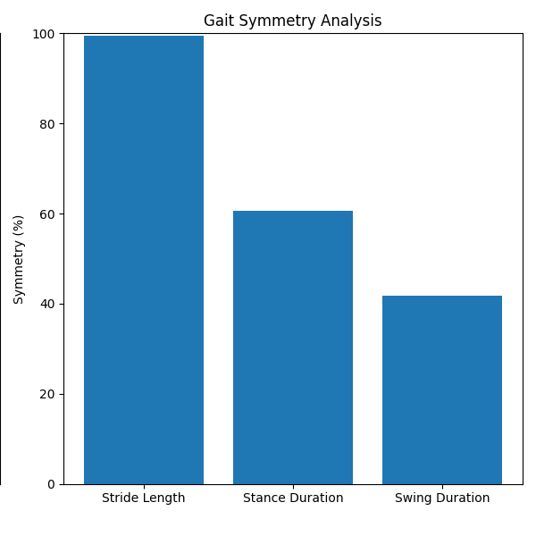
GaitSynergy: Redefining Gait Analysis with Vision-EMG Convergence for Precise Neuro-Muscular Evaluation
EXPERIMENTAL RESULTS
Fig.1. The figure above shows the graph for Stride Length Variation, Foot Clearance Variation and Stance, Swing and Stride Time Durations for a subject performing its natural gait cycle.
Fig.2. The figure above shows the graph for Cadence Variation and Gait Symmetry Analysis for a subject performing its natural gait cycle.

Slide 8
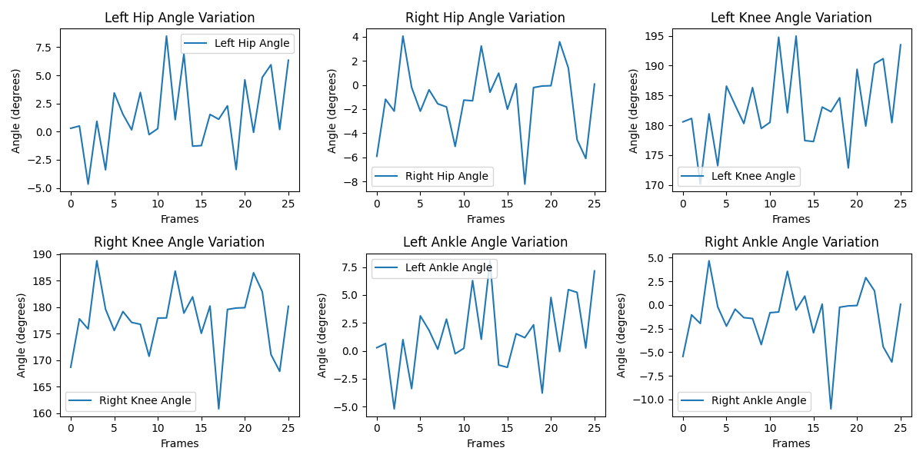
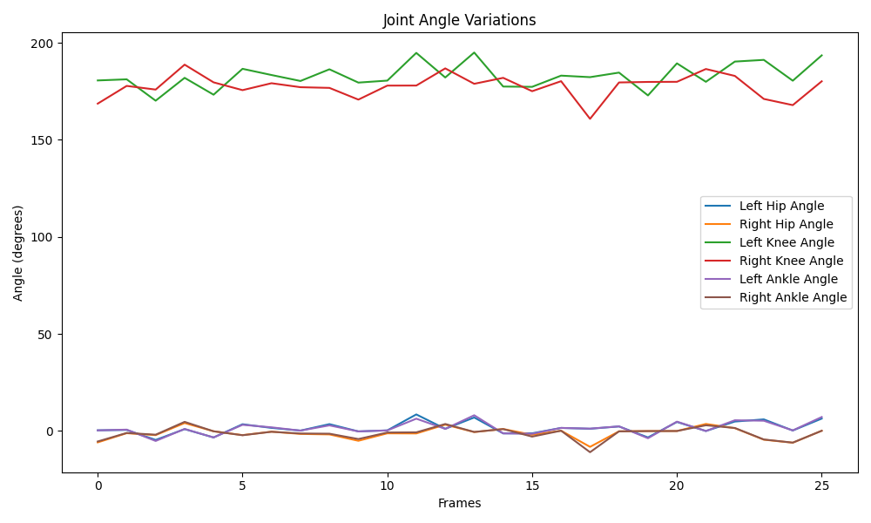
GaitSynergy: Redefining Gait Analysis with Vision-EMG Convergence for Precise Neuro-Muscular Evaluation
EXPERIMENTAL RESULTS
Fig.3. The figure above shows the graph for Left Hip Angle Variation, Right Hip Angle Variation Left Knee Angle Variation, Right Knee Variation, Left Ankle Angle Variation, and right Ankle Angle Variation for a subject performing its natural gait cycle.
Fig.4. The figure above shows the graph for Joint Angle Variations for a subject performing its natural gait cycle.

Slide 9
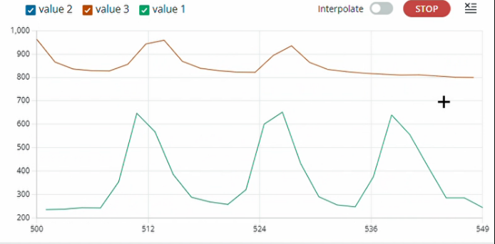
GaitSynergy: Redefining Gait Analysis with Vision-EMG Convergence for Precise Neuro-Muscular Evaluation
EXPERIMENTAL RESULTS
Fig.5. The figure above shows Activity Peaks Indicative of Muscle Flexion obtained from EMG sensor attached to lower limb muscles of a normal person .

Slide 10
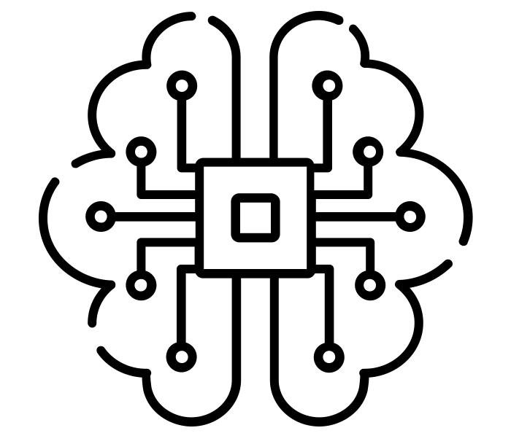

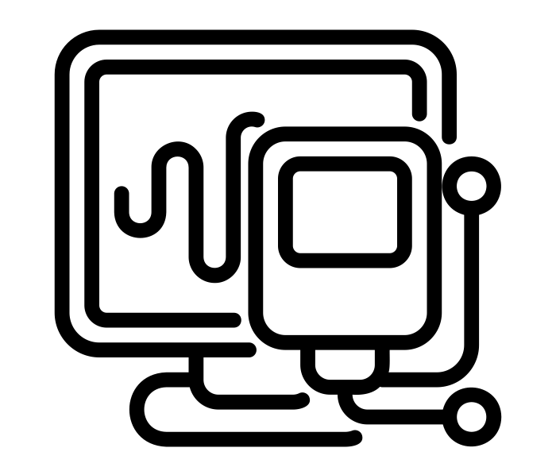

GaitSynergy: Redefining Gait Analysis with Vision-EMG Convergence for Precise Neuro-Muscular Evaluation
FUTURE SCOPE
Advanced ML algorithms
Web
application
Expand EMG Integration
Clinical Validation

Slide 11
GaitSynergy: Redefining Gait Analysis with Vision-EMG Convergence for Precise Neuro-Muscular Evaluation
CONCLUSION
An innovative approach to gait analysis and neuromuscular disorder assessment.
Utilizes the capabilities of computer vision and EMG sensor.
Offers a cost-effective and non-invasive solution for evaluating human locomotion.
An aid in early detection of neuromuscular disorders.
A broader applications across various domains.
Overcomes the constraints of traditional approaches.
An open avenue for more accurate diagnosis and monitoring of neuromuscular disorders.
The accessibility and affordability makes precise gait analysis available to a diverse user base, including healthcare professionals, researchers, athletes, and patients.

Slide 12
GaitSynergy: Redefining Gait Analysis with Vision-EMG Convergence for Precise Neuro-Muscular Evaluation
REFERENCES
Y. Yang, L. Yun, R. Li, F. Cheng, and K. Wang, "Multi-View Gait Recognition Based on a Siamese Vision Transformer," Applied Sciences, vol. 13, no. 4. doi: 10.3390/app13042273
F. Young, R. Mason, J. Moore, S. Stuart, R. Morris, and A. Godfrey, "A proposed computer vision model for running gait assessment," in 2022 44th Annual International Conference of the IEEE Engineering in Medicine & Biology Society (EMBC), 2022, pp. 4773-4776.
O. J.-E. M. RA;, “Vision-based Gait Impairment Analysis for aided diagnosis,” Medical &amp; biological engineering &amp; computing, https://pubmed.ncbi.nlm.nih.gov/29435705/ (accessed Nov. 10, 2023).
Saboor, A., Kask, T., Kuusik, A., Alam, M. M., Moullec, Y. L., Niazi, I. K., Zoha, A., & Ahmad, R. (2020). Latest Research Trends in GAIT Analysis Using Wearable Sensors and Machine Learning: A Systematic review. IEEE Access, 8, 167830–167864.
B, S. B., & Y, B. J. (2022). Vision-based gait analysis for real-time Parkinson disease identification and diagnosis system. Health Systems,1–11.

